Slide 1
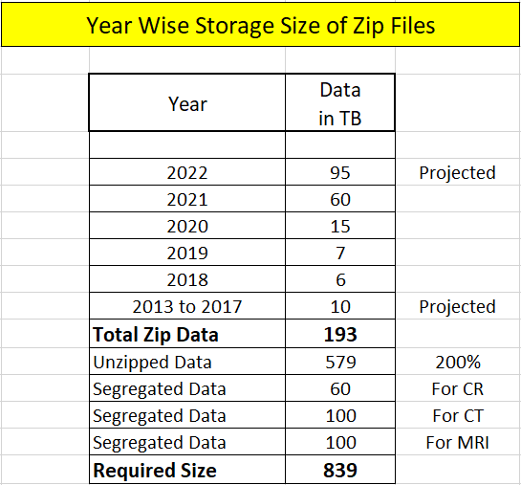
Year wise storage
Modality | Size per day
CR | 1 GB
MRI | 6 GB
CT | 30 GB

Slide 2

Storage Requirement
Server 1
CR
Server 2
CT
Server 3
MRI
100 TB
150 TB
150 TB
The Servers should have more slots.
The Storage should be movable.
SSD Storage (20 times more efficient).
Integrated Storage (No NAS or Cloud Storage).
Minimum 32 GB RAM.

Slide 3
Server Requirements for AI
Algorithm Training for Chest AI and Other AI’s
UAT
Machine
Production Server
Data Labeling
Workstations
Resources
Viewer
Validation of
Chest AI
Workstations
Resources
Viewer

Slide 4
Dell Krsnaa Server
20 TB Ubuntu Server
AI Training YOTTA Server
UAT Machine
Production Server
Validation
Machine
Low End Machines
Resources (Radiologists)

